Slide 1
Developing Quality Assessments
GBCS, 2014

Slide 2
Purpose of Common Assessments
Provide meaningful feedback to parents and students about student progress towards learning standards
Provide an overall assessment of student mastery of learning standards at the conclusion of a unit or marking period (summative)
Provide consistency of expectations
Can inform decisions about student placement
Provides feedback to the teacher, school, and/or district to inform curricular decisions

Slide 3
Step 1 – Define Purpose
Clearly define the purposes of the assessment. Is it diagnostic, formative, or summative? How will the results be used by students? By teachers? By the school or district? By others?
Center for Curriculum Renewal
www.curriculumrenewal.com

Slide 4
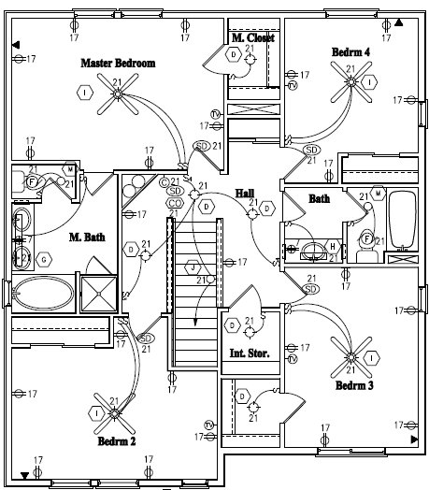
Step 2: Develop an Assessment Blueprint
What standards will be included in the assessment, and what types of questions?
Center for Curriculum Renewal
www.curriculumrenewal.com

Slide 5
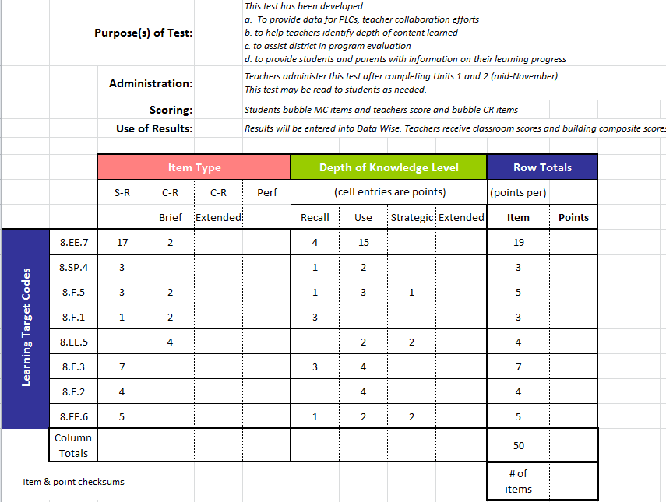
Assessment Blueprint Example
PURPOSE
DOK
ITEM TYPE
Total # of items = 50, but since CR items are each worth 2 pts., total points = 60.
STANDARDS
21
3
7
5
8
7
4
5
60

Slide 6
Step 3: Select or Develop Items
If high quality items exist and are available, it is almost always best to use them rather create new items. This is why access to release items and/or item banks is of immeasurable value. However, it is often necessary to create items to meet your individual needs.
In initially selecting or developing items it is best to select many more items than you will actually need
Center for Curriculum Renewal
www.curriculumrenewal.com

Slide 7
Variety of Assessment Strategies
Selected Response
Constructed
Response
Performance Assessment
Observations/
Conversations
Multiple Choice
True-False
Matching
Diagram
Fill-in-the-blank (words, phrases)
Essay
Short answer (sentences, paragraphs)
Web
Concept Map
Flowchart
Graph
Table
Matrix
Illustration
Presentation
Movement
Science lab
Athletic skill
Dramatization
Enactment
Project
Debate
Model
Exhibition
Recital
Performance Task
Oral questioning
Observation
Interview
Conference
Process description
Checklist
Rating scale
Journal sharing
Thinking aloud a process
Student self-assessment
Peer review
Adapted from the work of Dr. Robert Marzano
Michigan Assessment Consortium

Slide 8
Step 4 – Develop the Assessment
Be sure there is a balance of items with varying levels of cognitive complexity, also referred to as depth of knowledge.
Webb’s Depth of Knowledge (DOK) - A scale of cognitive demand (thinking) to align standards with assessments
Center for Curriculum Renewal
www.curriculumrenewal.com

Slide 9
Depth of Knowledge
Level 1 (Recall) – facts, figures, terms, simple procedures, etc.
Level 2 (Skill/Concept) – engagement of some mental processing beyond an habitual response.
Level 3 (Strategic Thinking) – requires reasoning, planning, using evidence, and a higher level of thinking than the previous two levels.
Level 4 (Extended Thinking) – requires complex reasoning, planning, developing, and thinking, most likely over an extended period of time.

Slide 10
Step 5: Administer and Score the Assessment
For common assessments to be truly common teachers need to set up common protocols for administration. These may include, for example, a common set of instructions, common protocols for response to students’ questions, materials allowable (such a dictionaries, calculators, or computers)
If the assessment includes constructed and/or extended response items it is important for scorers to grade sample assessments collaboratively to align their scoring expectations.
Center for Curriculum Renewal
www.curriculumrenewal.com

Slide 11
When completed, the outcome is…
A quality assessment which provides meaningful results and for which decisions made with the results are justifiable.

